Slide 1
Game analytics in general
Capturing, analyzing and interpreting
User behavior
Telemetry

Slide 2
Game analytics in general
Events:
Start time and duration
Certain features that are over/underused
Performance events
Number of errors from the player
…

Slide 3
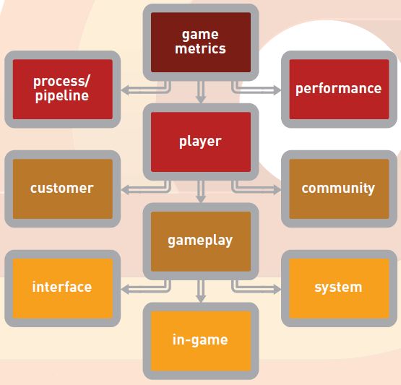
Game analytics in general
Game metrics
Source: https://www.gamasutra.com/ view/feature/193241/intro_to_user_analytics.php

Slide 4
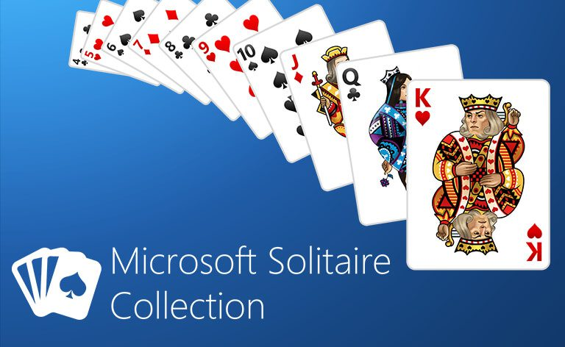
Dr. solitaire
Overlay for Solitaire
Cognitive performance
Source: https://community.microsoftcasualgames.com/
games/microsoft-solitaire-collection/

Slide 5
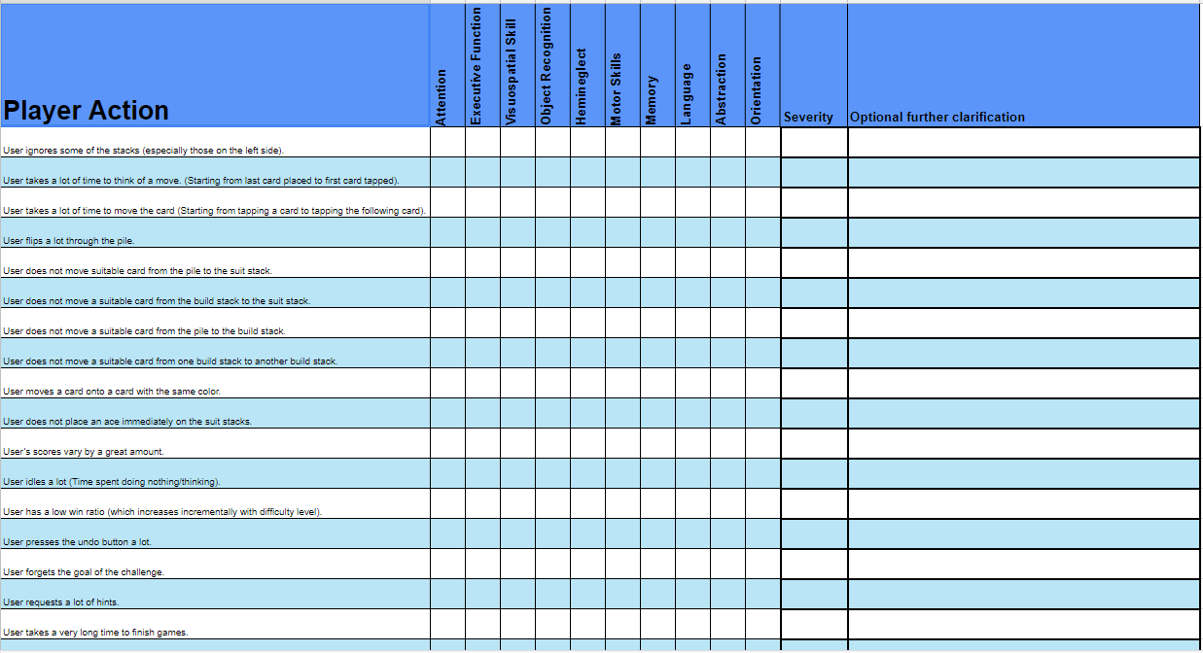
Dr. solitaire

